Slide 1
Title of the project
Group No: E3 Date:14/11/14
Team Members
Gopi Thulasinathan T - CB.EN.U4CSE11414
Sravanthi N - CB.EN.U4CSE11428
Narasimha Prasath K - CB.EN.U4CSE11429
Rahul E - CB.EN.U4CSE11439
Varun Kumar A - CB.EN.U4CSE11458
PROJECT GUIDE :
Ms. Padmavathi S.
Project Advisor (Guide) : Name / Designation
Project Advisor (Co-Guide) : Name / Designation / Department

Slide 2
Content (Max No. of Slides = 6)
Problem Statement - ( 1 Slide)
Literature Survey Details- (Min 2 Slides)
System Design ( Max 2 Slides)
Implementation Screen shot ( Max 2/3 slides) – with demo ( 30%of the implementation)
References (Reference format to be strictly followed as per the next slide) ( 1 Slides)
Date:
Project Group No:

Slide 3
Problem Statement
To gather a input scene and represent the scene as a set of objects.
To analyze the nature of the objects and represent its properties namely posture.
To develop Articulated human body model by using the limbs and joints, and to track the human motion in a video sequence.
Date:
In-House Project Group No:

Slide 4
Literature survey
Author : FY Abdul Rahman, Halimah Badioze Zaman, Nooritawati Md Tahir
Year : 5th September,2013
Approach/Algorithm/Metholody used:
Traditional background subtraction
BGS techniques
Merits:
Hybrid technique (SDGD + 4 BGS techniques)
enhanced segmentation performance
More accuracy
Date:
In-House Project Group No:

Slide 5
DEMERITS:
Not applicable for real-time applications
Computational time is more

Slide 6
Author: J. Park, A. Tabb
Year : 2006
Approach/Algorithm/Metholody used:
SDGD model
Image Processing basic techniques
MERITS:
Usage of Second derivatives
Date:
In-House Project Group No:

Slide 7


SDGD filter
A filter that is especially useful in edge finding and object measurement is the Second-Derivative-in-the-Gradient-Direction (SDGD) filter.
This filter uses five partial derivatives:
Where
Axy = Ayx which accounts for the five derivatives.
Date:
In-House Project Group No:

Slide 8
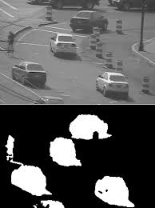
Date:
In-House Project Group No:

Slide 9

System Design
Input
Noise removal
Tracking
Object labelling
Date:
In-House Project Group No:

Slide 10
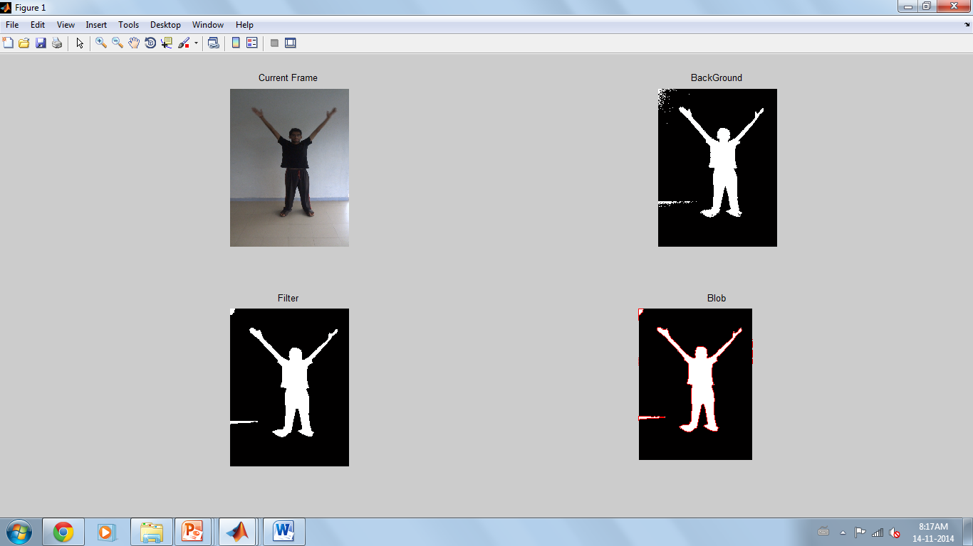
Date:
In-House Project Group No:

Slide 11
References
J. Park, A. Tabb, and A. C. Kak, “Hierarchical data structure for real-time background subtraction,” in Proceedings of the IEEE International Conference on Image Processing (ICIP '06), pp. 1849–1852, October 2006. View at Publisher · View at Google Scholar · View at Scopus
I. J. Young, J. J. Gerbrands, and L. J. van Vliet, “Fundamentals of Image Processing,” Version 2. 3, 1995–2007.
V. G. Narendra and K. S. Hareesh, “Study and comparison of various image edge detection techniques,” International Journal of Image Processing, vol. 4, no. 2, article 83, 2009.
Date: 11/14/2014
In-House Project Group No:

Slide 12
I. T. Young, “Generalized convolutional filtering,” in Proceedings of the 19th CERN School of Computing, pp. 51–65, 1996.
“Image processing fundamentals: derivative-based operation,” 2011, http://www.mif.vu.lt/atpazinimas/dip/FIP/fip-Derivati.html.
A. Mittal and N. Paragios, “Motion-based background subtraction using adaptive kernel density estimation,” in Proceedings of the IEEE Computer Society Conference on Computer Vision and Pattern Recognition (CVPR '04), pp. II302–II309, July 2004. View at Scopus
Date:
In-House Project Group No:

Slide 13
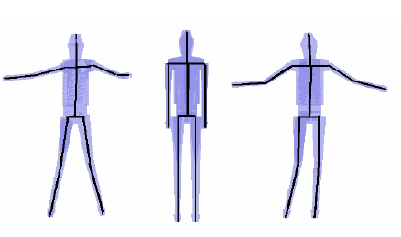
Modeling the object being tracked

Slide 14
REFERENCES
Mun Wai Lee and Isaac Cohen, “Human Upper Body Pose Estimation in Static Images”, T. Pajdla and J. Matas (Eds.): ECCV 2004, LNCS 3022, pp. 126–138, 2012, Springer-Verlag Berlin Heidelberg 2012.
Li, Jing-Feng, Xu, Yi-Hua; Chen, Yang; Jia, Yun-De “A Real-Time 3D Human Body Tracking and Modeling System” IEEE International Conference on Image Processing, 2011
MANIMALA S & C. N. RAVI KUMAR, ENVISAGING TORSO AND FOOT FEATURES OF HUMAN BODY USING TOPINARD’S CANON SYSTEM, International Journal of Management, Information Technology and Engineering, Vol. 2, Issue 1, Jan 2014, 91-96
http://www.cvpapers.com/eccv2011.html
Date:
In-House Project Group No:

